Slide 1

AFTER REMAINS OF CORONA ON
IT INDUSTRY
WE HAVE BEEN HIT HARD THIS YEAR
EVERY THINGS IS JUST SHUT DOWN AND ALL THINGS JUST PAUSES ITSELF
CORONA LED US TO LIVE A WHOLE YEAR IN DOING NOTHING
FROM SMALL LABOURS , FARMERS , SHOPPERS , JOBBERS , GOVERNMENT , COUNTRIES , AND EVEN THE WHOLE WORLD IS FACING NEGATIVES IMPACT OF CORONA ON THEMSELVES
WHILE EVERYONE IS FACING THE NEGATIVES THERE IS ONE INDUSTRY THAT SHOWING US A WAY THAT IN BETWEEN EVERY CRITICAL CONDITIONS , IF ONE MOTIVATE ONESELF THEN THEY CAN ACHIEVE ANYTHING
SO “AFTER EFFECTS OF CORONA ON IT INDUSTRY” IS ALL ABOUT THE IMPACTS BEFORE AND AFTER ON THIS INDUSTRY BY CORONA AND WHAT ONE CAN LEARN FROM AND BELIEVE ME THERE ARE MANY
BY
SANJEEV KUMAR SINGH 00711404419
KUMAR GAUTAM 01211404419

Slide 2


AFTER REMAINS OF CORONA ON
IT INDUSTRY
LETS HAVE A BRIEF LOOK AT THE “BEFORE CONDITION OF IT INDUSTRY”
SO BEFORE CORONA IT INDUSTRY DOESN’T HAVE THE EXPOSURE AS
AFTER CORONA
WHEN ONE THINK ABOUT THE INDUSTRY , THEY JUST GET THE INDUSTRY WHICH DEALS WITH NETWORKS , COMPUTERS ETC
LIKE
“IT INDUSTRY DEALS WITH MOBILE NETWORKS.”
“IT INDUSTRY DEALS WITH THE COMPUTERS.”
IN OUR COUNTRY “IT INDUSTRY MEANS WIPRO AND INFOSYS JUST TWO”
THESE ARE SOME BASIC ASSUMPTIONS THAT WAS MADE BEFORE CORONA ABOUT THE IT INDUSTRY
BY
SANJEEV KUMAR SINGH 00711404419
KUMAR GAUTAM 01211404419

Slide 3

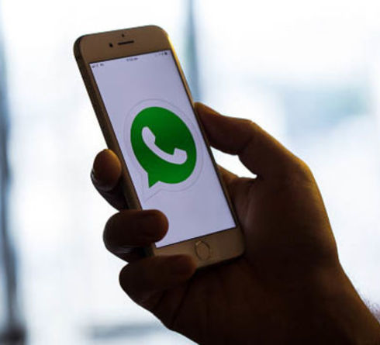

AFTER REMAINS OF CORONA ON
IT INDUSTRY
BY JUST LOOKING BACK WE CAN EASILY ANALYZE ALL BY OURSELVES THAT
BEFORE CORONA THERE WERE NOT MUCH OF ANY DEVELOPMENT IN OUR IT SECTOR
LIKE
FOR VIDEO CALLING WE JUST HAD WATSAPP , FBMESSENGER, GOOGLE DUO , ON WHICH WE CAN DO LIMITED GROUP CALLS (EITHER VIDEO OR AUDIO)
FOR OUR ENTERTAINMENTS WE HAD TO GO TO THEATRES TO WATCH SOME MOVIES .
FOR DOING OUR CLASSES WE HAD TO BE PHYSICALLY PRESENT
LIMITED DEVELOPMENTS

Slide 4

AFTER REMAINS OF CORONA ON
IT INDUSTRY
NOW AFTER CORONA
BASICALLY THIS IS THE LONE SECTOR WHICH HAS THE MOST PROFITS IN TERMS OF MONEY AND RESOURCES , EVEN THOUGH CORONA WAS ALL ON ITS VERGE OF EXPANSION , THE INDUSTRY LONE SURVIVES AT ITS VERY BEST .
AFTER CORONA THE INDUSTRY GAINED MORE NUMBER OF TECHNOLOGIES , THE INDUSTRY BOOSTED UP THEIR NETWORK CHAIN FLOW THAT THE DATA TRANSMISSION CAN BE DONE SMOOTHLY AND EFFECTIVELY
WHATELSE WHERE THE INDUSTRY DOESN’T LOOK THE AREA WITHIN ITSELF IS NOW THE MOST SECURED AND POWERFUL
LIKE
THE IT SYSTEM SECURITY IS NOW BEING THE MOST PREFERRED LIST
BEFORE WE HAVE JUST WATSAPP FOR VIDEOCALLING ETC NOW WE HAVE GIVEN MULTIPLE OPTIONS AND DAY BY DAY ITS EVOLVING.
BY
SANJEEV KUMAR SINGH 00711404419
KUMAR GAUTAM 01211404419

Slide 5
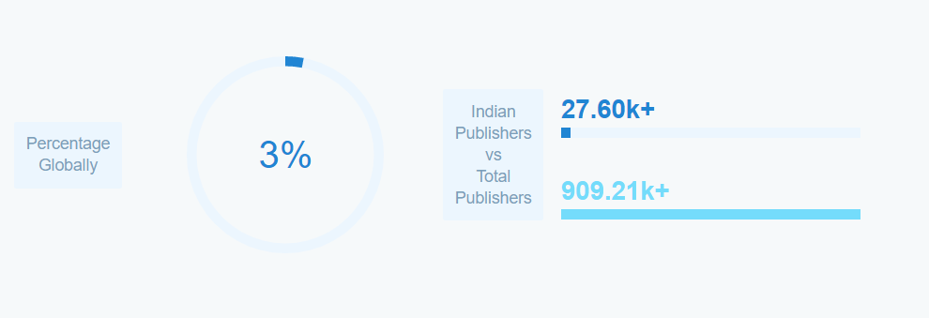
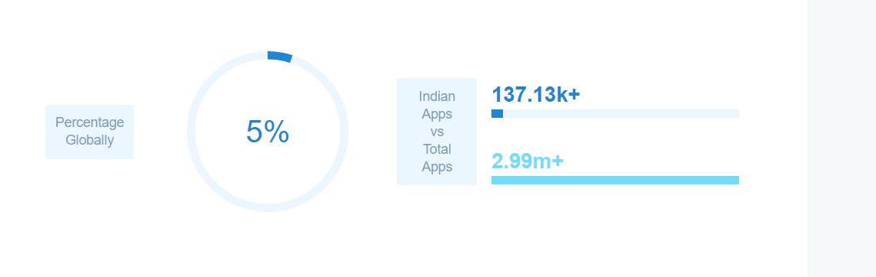
AFTER REMAINS OF CORONA ON
IT INDUSTRY
SO WE CAN DEFINITELY SAY THAT FOR ALL OTHERS SECTORS “CORONA HAS COME AS A FOE BUT FOR THE IT SECTOR CORONA ARRIVE LIKE A FRIEND”
ACCORDING TO VARIOUS REPORTS
THE APP PUBLISHERS %TAGE GROWS FROM 2 TO 3% GLOBALLY FOR INDIA
THE NUMBERS OF APPS BY INDIA ALSO SEEN GROWTH FROM 4 TO 5% GLOBALLY
APP PUBLISHER %TAGE
APP BY INDIANS %TAGE

Slide 6
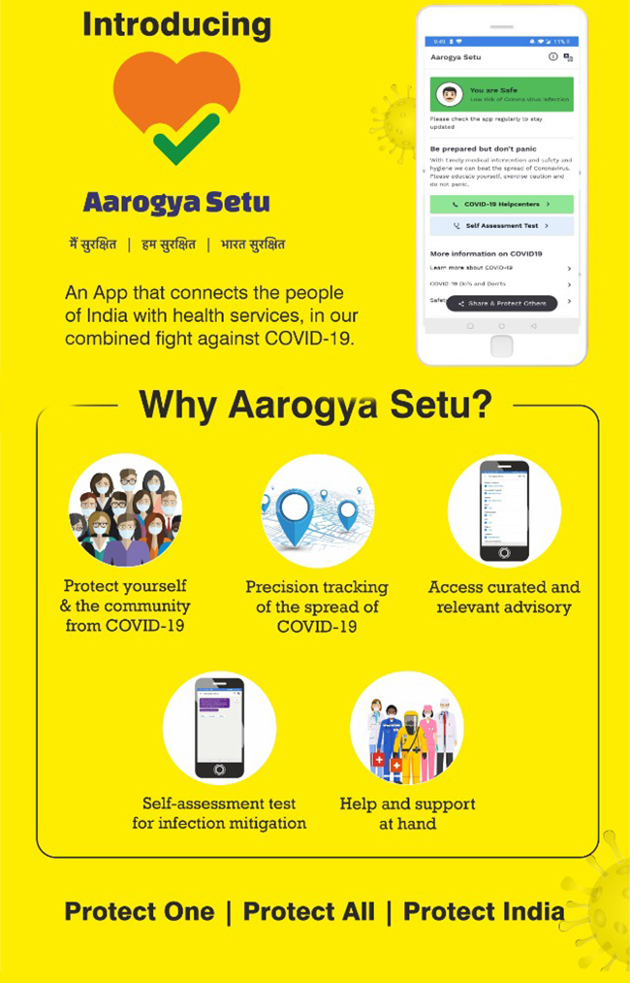
AFTER REMAINS OF CORONA ON
IT INDUSTRY
SO NOW FROM ALL OF THAT TECHNOLOGY AND NETWORK STRENGTH WE CAN ACHIEVE GREATNESS IN TERMS OF HEALTH , ENTERTAINMENT , FULL LIFE FOR OUR COUNTRY IF PROPERLY USED
LIKE AT THESE TIME WE GET AN APP KNOWN AS “AAROGYA SETU” . THE APP IS DEVELOPED UNDER INDIAN GOVERNMENT VISION AND QUITE USEFUL BUT IT IS NOT AS GOOD AS IT SHOULD BE
SEE IN THE APP THERE’S A FLAW , THAT IS THE CHECKING SYSTEM FOR A COVID INFECTION IS MADE TOTALLY USER INPUT DEPENDENT , SO IT IS VERY EASY TO BYPASS THAT AND MAKE ONESELF SAFE , IT DOESN’T MATTER THAT THE ONE IS INFECTED OR NOT
LIKE USER JUST HAVE TO ANSWER ALL THE QUESTIONS FOR THE SYMPTOMS TO “NO” AND THEN ALL THINGS DONE AND DUSTED .
PRETTY EASY TO BYPASS AND MAKE ONE SAFE

Slide 7
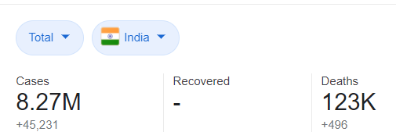
AFTER REMAINS OF CORONA ON
IT INDUSTRY
NOW THE APP IS NOT MUCH OF A USE IN TERMS OF ITS WORKING
SO WHAT CAN BE DONE AFTER THIS
MY IDEA IS THAT THIS APP IS A GEM BUT NEEDS A CHANGEOVER AND THIS CAN BE DONE BY JUST UPDATING SOME FEATURES IN IT , SO THAT THE USEFULNESS OF IT CAN BE ACHIEVED
LOOK OUR COUNTRY IS IN VERY BAD SITUATION IN TERMS OF ITS HEALTH SERVICES AND FACILITIES , AND WE KNOW THAT
ACCORDING TO REPORTS THERE WERE THOUSANDS EVEN LAKHS OF DEATH HAPPENED IN JUST OVER 9 MONTHS IN COVID IN INDIA AND THAT JUST BECAUSE THE SOME DIDN’T GET THE BEDS AND TREATMENT ON TIME AND ALSO MANY HAPPENED DUE TO PREVIOUS HEALTH ISSUES .
REPORTS ALSO SUGGESTS THAT THE NUMBER OF DEATH IS MORE IN THE PATIENTS WHO HAD PREVIOUS HEALTH ISSUES LIKE HEART DISEASE OR DIABETES AND AS THE PATIENTS DIDN’T KNOW ABOUT THEIR PREVIOUS CONDITIONS THEY SUFFERED MORE
DEATHS TILL NOW IN JUST 9 MONTHS FROM 1 DEATH, 13 MARCH 2020
PREVIOUS HEALTH ISSUES MORE NUMBER OF DEATHS

Slide 8
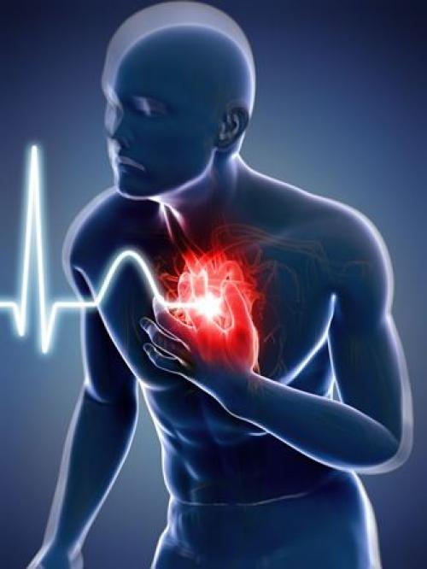
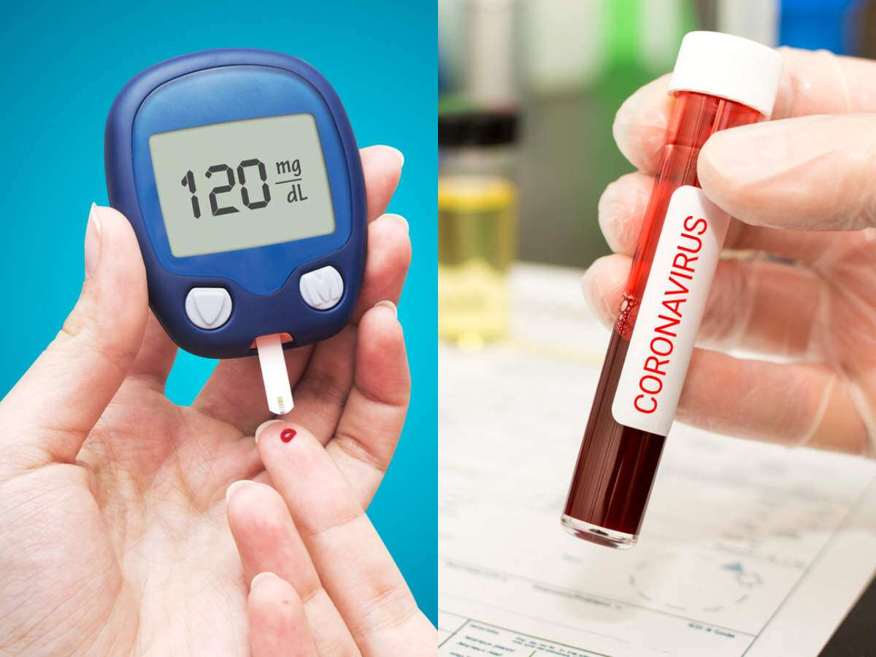
AFTER REMAINS OF CORONA ON
IT INDUSTRY
VARIOUS SURVEYS CONCLUDED THAT
EVERY ONE IN A 4 PERSON DIES DUE TO HEART DISEASE , THAT IS MAILY BECAUSE OF CARDIO VASCULAR DISEASES
THESE DISEASES ARE MAINLY BECAUSE OF HIGH AND LOW BLOOD PRESSURE
EVEN MORE TO THE FACT ONE IN EVERY 6 PERSON IN INDIA DIES DUE TO DIABETES
THESE ARE SOME ISSUES WHICH IF PEOPLE TAKE CARE THEY CAN EASILY MAINTAIN LONGER LIFE SPAN
SO WHAT CAN BE DONE TO DERAIL THAT DATA , SO THAT THE HEALTH ISSUES CAN DETECT AT THEIR EARLIEST FOR THE ISSUES SO THAT THE SYSTEM CAN SAVE SOME DAMAGES FOR THE FUTURE
EVERY 1 PERSON IN 4 IN INDIA HAVE HEART DISEASES
EVERY 1 PERSON IN 6 IN INDIA HAVE DIABETES

Slide 9
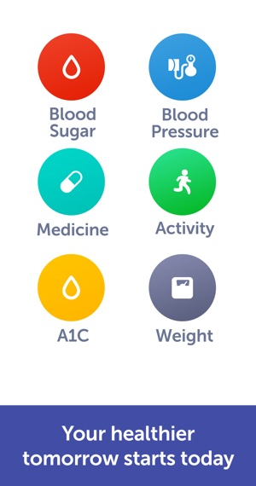
AFTER REMAINS OF CORONA ON
IT INDUSTRY
NOW CORONA HAS GIVEN HAS SOME SOURCES THAT CAN HELP IN MAINTAINING THESE SEE HOW
IF WE JUST ADD SOME FEATURES LIKE
UPDATING BLOOD PRESSURE AND DAIBATIC LEVELS FOR EVERY ONE OF US TO THE “AAROGYA SETU” APP
GOVERNMENT CAN USE HOSPITALS TO UPDATE THE PATIENTS DATA TO FEED IN THAT APP IF THE INDIVIDUAL IS NOT ABLE TO DO THAT .
ON THE BASIS OF THAT DATA , GOVERNMENT CAN ADVICE THE INDIVIDUAL TO PROPER CARE LIKE THEY TELL ON BEING CHECKED COVID ACTIVE ON THE SETU APP .
UPGRADATION CAN BE DONE IN THE “AAROGYA SETU APP”

Slide 10
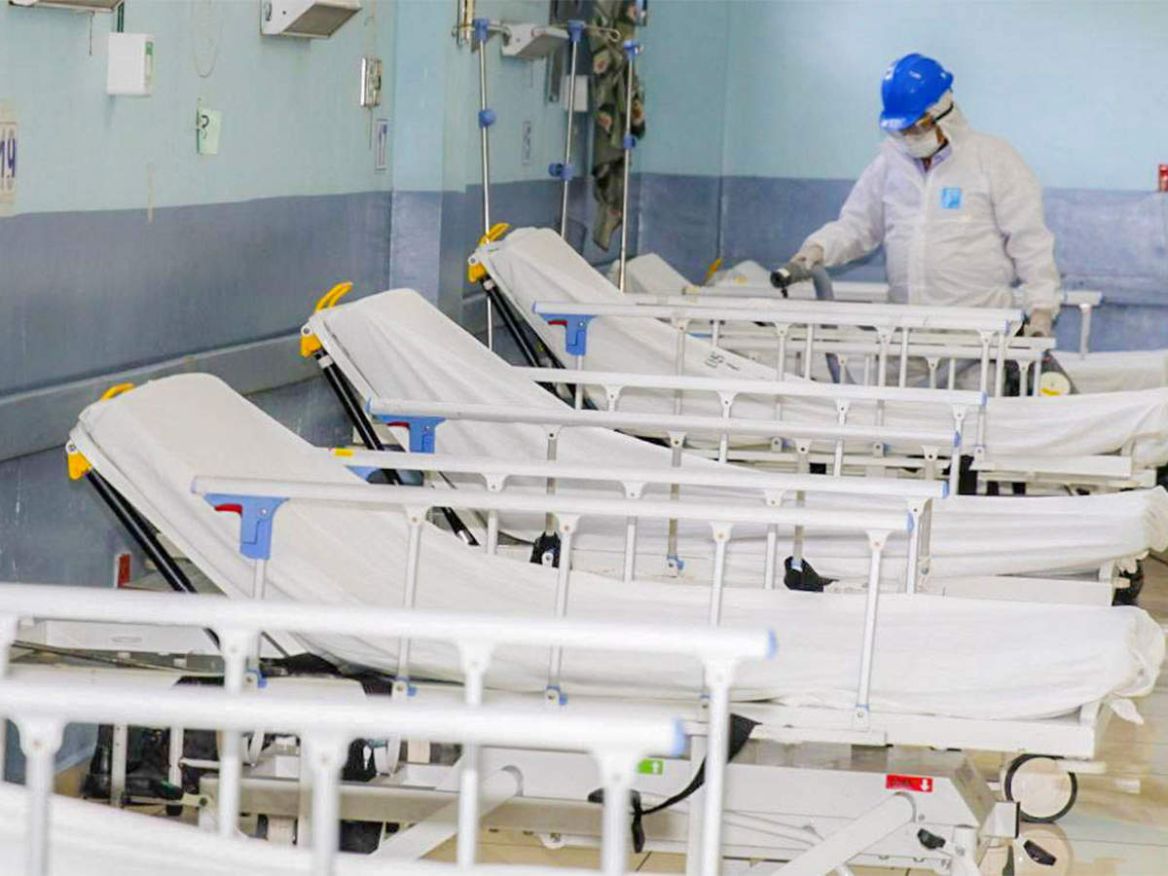
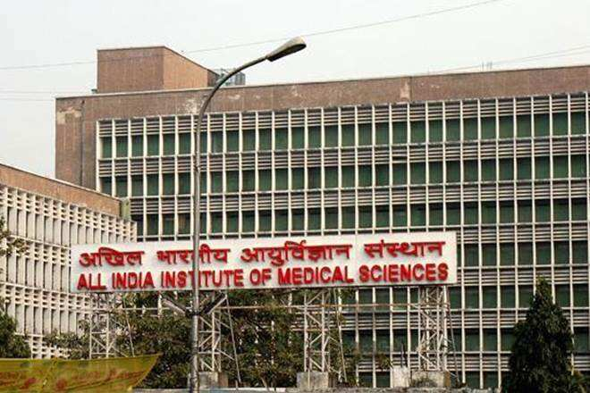
AFTER REMAINS OF CORONA ON
IT INDUSTRY
CONCLUSION
GOVERNMENT CAN USE THIS DATA TO MAINTAIN PEOPLE HEALTH AND CARE ALL THROUGH AN APP
ON THE BASIS OF DATA COLLECTION GOVERNMENT CAN SET UP PROPER HOSPITALS AND SERVICES ON WHERE ITS ACTUALLY NEED THE MOST NOT JUST ANYWHERE TO GET SOME VOTES AND MAKE GOVERNMENTS IN EVERY ELECTION TO RULE
AS THE DATA WILL BE COLLECTED USING LOCATION , GOVERNMENT CAN EASILY DETECT SERIOUS AREAS AND LOW SERIOUS AREAS AND THEN CAN ACT ACCORDINGLY
THESE ARE SOME MY CONCLUSIONS
SERVICES CAN BE IMPROVED WITH THAT DATA

Slide 11

AFTER REMAINS OF CORONA ON
IT INDUSTRY
WE ALL HAVE BEEN HIT HARD AND CORONA HAS ITS EFFECT LIKE EVERYWHERE ON THE PLANET .
JUST ONE SECTOR HAS SHOWN SOME IMPROVEMENT AT THESE TIMES AND WE MUST USE THE RESPECTIVE SECTOR RESOURCES TO SHOW THAT WE CAN BE IMPROVE IN WHERE WE HAVE BEEN HIT HARD
WE DON’T KNOW WHAT FUTURE HAS IN ITS POCKET FOR US BUT COVID 19 HAS DEFINITELY SHOWN US THAT NO MATTER WHAT WE MUST
IMPROVE OUR HEALTH SERVICES , SO THAT WE CAN IMPROVE EVERYWHERE
AS A FAMOUS QUOTE SAYS
“HEALTH IS WEALTH”

Slide 12
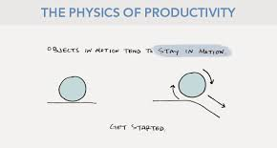
AFTER REMAINS OF CORONA ON
IT INDUSTRY
SO ULTIMATELY WE CAN SAY THAT THE IT INDUSTRY HAS PROVED THE NEWTON’S FIRST LAW OF MOTION CORRECT THAT IS
“A body at rest remains at rest or, if in motion, remains in motion at constant velocity unless acted on by a net external force.”
AT THIS CORONA TIME WHEN EVERYTHING COMES AT REST
THE IT INDUSTRY PUT THEIR SHOES UP AND HIGH AND SHOWED US ALL A WAY TO KEEP MOVING FORWARD .
THEY HAVE SHOWED THAT
“NECESSITY IS THE MOTHER OF INVENTION AND CAN BE DONE BY ANYONE , JUST NEED THE WILL AND COURAGE.”
BY
SANJEEV KUMAR SINGH 00711404419
KUMAR GAUTAM 01211404419

